Slide 1


SIMATS ENGINEERING
Saveetha Institute of Medical and Technical Sciences Chennai-602105.
CSA0412 – Operating System
Operating System in a Banking System Handling Thousands of Transactions
Presentation by :
Kamesh S(192521358)
Supervised by :
Dr.Riasudheen

Slide 2

INTRODUCTION
A bank serves thousands of customers at the same time: ATMs, net banking, mobile apps, UPI and branch counters.
Each request is a transaction: balance check, deposit, withdrawal or transfer.
Every transaction must be fast, correct and secure
Why the Operating System matters:
The OS is the layer between the banking application / database and the hardware.
It schedules processes, manages memory, files and devices, and protects data.

Slide 3
OBJECTIVE
To understand the role of an Operating System in managing banking operations and resources.
To study how the OS handles thousands of simultaneous banking transactions efficiently.
To analyze CPU scheduling, memory management, and process management in banking systems.
To understand how the OS supports communication between banking applications, servers, ATMs, and databases.

Slide 4
Types of Operating System
OS type | Key feature | Banking use | Suitable?
Batch | Jobs run in groups without user interaction | End-of-day interest, statements, reports | Partly (back-office)
Multiprogramming | Several programs kept in memory; CPU never idle | Many transactions share the CPU | Yes
Time-sharing (multitasking) | CPU time sliced among many users | Many users on terminals / net banking | Yes
Multiprocessor (parallel) | Many CPUs share memory and work | Run thousands of threads in parallel | Yes (core)
Distributed | Many machines act as one system | Branches, data centres, ATMs, disaster recovery | Yes
Real-time (RTOS) | Guaranteed response deadlines | ATM, card payment switch, fraud checks | Yes (for critical parts)
Single-user desktop | One user at a time | Bank employee PC only | No (server)

Slide 5
Requirements of Banking Workload
Requirement | Meaning for banking | OS support needed
High concurrency | Thousands of transactions at once | Multiprogramming, multithreading, multiprocessor scheduling
Correctness (ACID) | No lost or partial updates | Synchronisation, locking, atomic file/disk writes
Low response time | Customer gets reply in seconds | Efficient scheduling and I/O, real-time priorities
Reliability / availability | 24 x 7 service, no data loss | Fault tolerance, journaling file system, backups
Security | Only authorised access to accounts | Authentication, access control, encryption, audit logs
Scalability | Growing customers and branches | Multiprocessor and distributed support

Slide 6
Operating System Structures
Structure | Idea | Advantage | Drawback
Monolithic | All OS services in one large kernel | Fast (no message passing) | One bug can crash the whole system
Layered | OS built in layers; each uses the one below | Easy to debug and verify | Layer overhead; hard to define layers
Microkernel | Minimal kernel; services run as user processes | Reliable, secure, easy to extend | Message passing is slower
Modular (loadable modules) | Monolithic core + modules loaded on demand | Flexible and fast (Linux) | Modules run in kernel mode
Hybrid | Mix of microkernel and monolithic ideas | Balance of speed and safety | More complex design

Slide 7
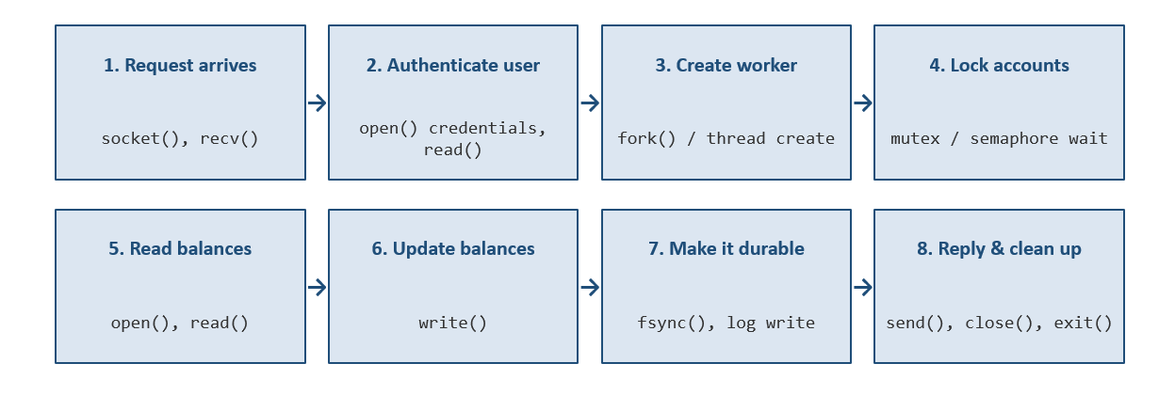
Role of System Processing in Transaction Processing

Slide 8
Conclusion
The Operating System plays a vital role in managing banking operations and processing thousands of transactions efficiently.
It manages CPU scheduling, memory, processes, storage, and network communication.
It supports secure communication between banking applications, servers, and databases.
Proper resource management and database transaction control help maintain data consistency and system reliability.

Slide 9


